Slide 1
TravelNow
TravelNow
Group 7 :
Christian Frans Mukuan
Deyaninta Ekabriela Permata
Mufadhal Faraz Addhifa
Notes:
Good Morning, Everyone!
Today, we are going to presentate our project.
And let us introduce ourselves.

Slide 2


Slide 3

Agenda
01
What is TravelNow ?
02
Why do we choose TRAVELNOW ?
03
Flowchart of TRAVELNOW
04
Pseudocode of TRAVELNOW
05
Dry Run of TRAVELNOW
Notes:
So, here are our agenda for today’s Project.
The first, we will talk about What is TravelNow,
The second, we will talk about Why do we choose TravelNow
The third, we will show you the Flowchart that we have made for this Project
The fourth, we will show you the Pseudocode
The fifth, we will show you the Dry Run

Slide 4
What is TRAVELNOW
Notes:
What is travel now?

Slide 5
Flight
Hotel
Tour
Transportation
Tour Guide
Notes:
TravelNow is an Indonesian startup company that provides flight ticket booking services, hotel tickets, tour tickets, and transportation service. Based on operations in Jakarta, TravelNow is focused on helping to manage the needs of Indonesian public holidays or business trips to several Asian countries. TravelNow claims to have been connected directly with 9 countries in Asia that have two choices of the best destinations, such as metropolitan and nature. TravelNow also offers several packages for those of you who want to go to 3 countries at once, in collaboration with the 3 best hotels, and tour guide services that you can be select from local to international tour guides. What countries do we offer? So, the countries that you can visit are Singapore, Malaysia, Thailand, Vietnam, Hong Kong, Turkey, Japan, South Korea, and China.

Slide 6
Packet Selection
Nature
Metropolitan
Notes:
In the previous slide, we have tell you about many services that can be booked in our Platform.
But, this slide is all about the best services from our Platform.
Packet Selection,
It divided into 3 Packet,
Tera, Giga, and Mega.
One of the differences in many packets are the Places Destination.
It contains of Nature, and Metropolitan
If you choose a packet that include Nature in it, we will take you to geographical places that having a physical and cultural individuality developed through natural growth rather than design or planning
If you choose a packet that include Metropolitan in it, we will take you to a large urban area

Slide 7
Why do we choose TRAVELNOW
Notes:
Why do we choose TravelNow?
For now, vacation really needed by any person all around the world. People’s activity nowadays that make them hard to book tickets for the vacation. With TravelNow people must be easy to go to their vacation, because we have conclude all aspects started from ticket bookings, until Tour Guide.

Slide 8
Flowchart of TRAVELNOW
Notes:
Lets see our flowchart in this project

Slide 9
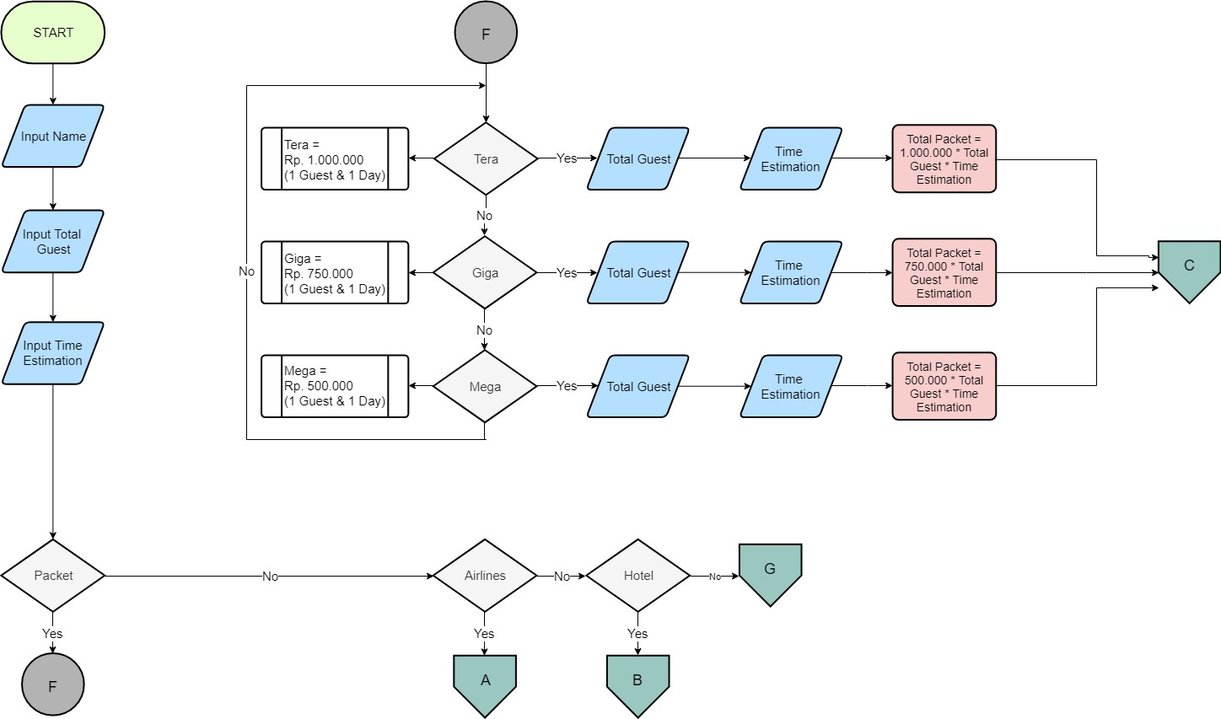
Notes:
As you can see,
You can input your name, total guest, and time estimation for the bookings.
Then, the bookings are divided into 3 selection.
It contains of Packet Selection, Airlines Selection, and Hotel Selection.
You can choose 1 of them, 2 of them, or even all of them
The first, we will talk about the Packet Selection.
It divided into Tera, Giga, and Mega. (ini ngebacot aja ttg definisi masing masing paket)
Then all of it have the same logic for the payment.
The prices of its packet multiple with the total guest that you have inputed in the beginninng and then multiple again with the time estimation that you have inputed in the beginning too.
All of it continued into the next step, customer data.
But before we continue to the customer data, we will talk about the next bookings selection, Airlines Selection.

Slide 10
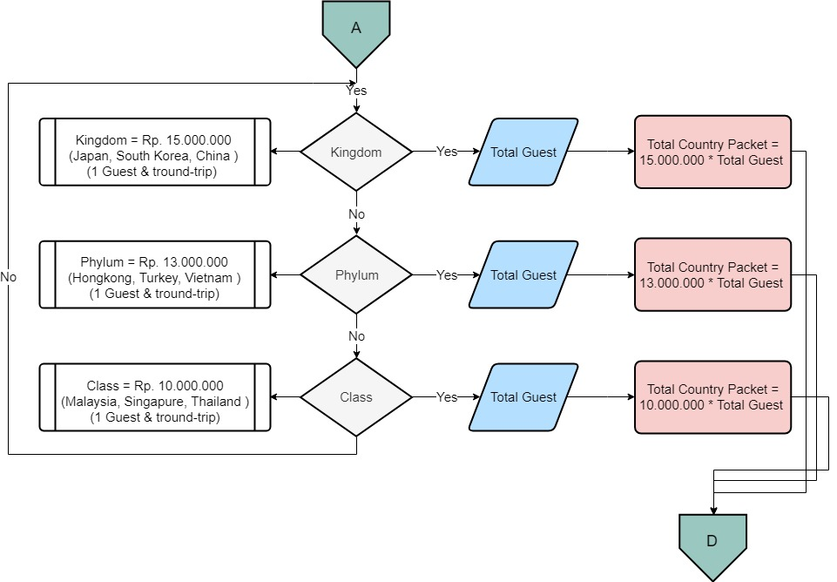
Notes:
This is the Airlines Selection that we have divide into 3 packets.
The first, Kingdom it contains of (notes)
The second, Phylum (sama kyk atas)
The third, Class (sama kyk atas)
The logic is pretty similar with the previous bookings selection.
The prices of the packet multiple with the total guest that you have inputed in the beginning
Then all of it continued into the customer data too.
But, before we talk about the customer data. I will show you about the next bookings selection, Hotel Selection.

Slide 11
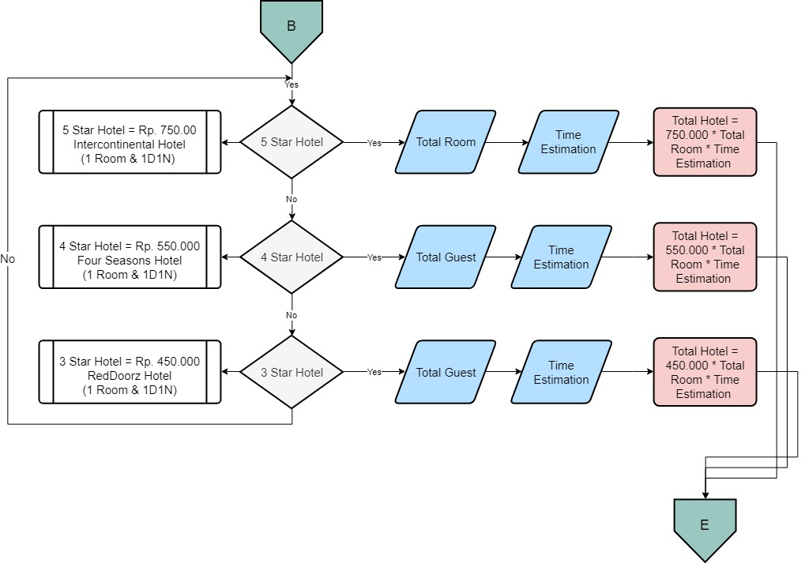
Notes:
So, this is the last bookings.
The Hotel selection divided into 3 selection
It contains of 5 star hotel, 4 star hotel, and 3 star hotel.
(omongin notes masing masing hotel)
The payment logic is same with the Packet selection, but the different is the price contains about the hotel prices.
So, the logic is hotel prices multiple with Total rooms and then multiple again with the time estimation.
And then it continues to the Customer Data Procedure

Slide 12
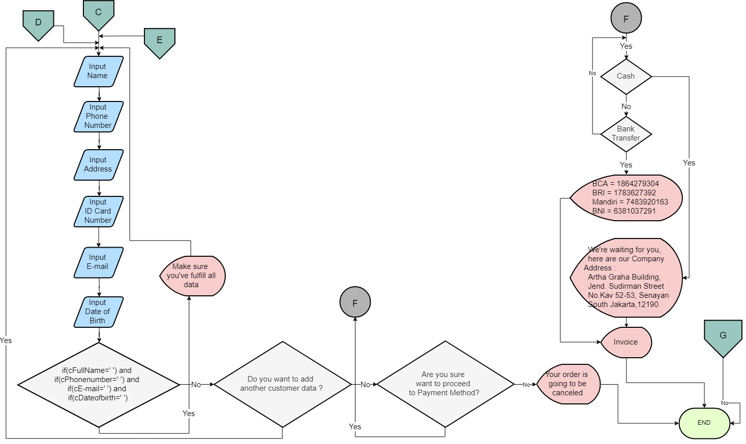
Notes:
All of the bookings selection, contains of Packet Selection, Airlines Selection, and Hotel Selection continued to the Customer Data Procedure.
In this Procedure, the Customer needs to input their Fullname, Phone Number, Address, ID Card Number, E-mail, and Date of birth.
The logic of Customer Data Form is if Fullname and Phone number and E mail and Date of birth is empty, you need to fill it again.
If all the data have fulfilled, the next decision is are the customer want to add another data.
If yes, the customer needs to fill the form again.
If not, the customer meets the next decision. It’s the verification are he or she wants to proceed to the Payment Procedure.
If Not, the customer will meet the display “ Your order is going to be canceled” and then the flowchart ends.
If Yes, they need to choose the Payment Method
It contains of Cash and Bank Transfer
If Cash, they need to go to the address that we have displayed
If Bank Transfer, they need to choose the virtual account that we have been displayed. Then the invoice of the payment will be displayed.
Flowchart ends.

Slide 13
Pseudocode of TRAVELNOW
Notes:
Next, pseudocode of TravelNow

Slide 14
begin
display '------------WELCOME-----------'
display 'Travel with Us, Now! TravelNow'
procedure pRegister
procedure pPacket
procedure pAirlines
procedure pHotel
procedure pCustomerData
procedure pPayment
numeric nTotalCountryPacket, nTotalHotel, nTotalPacket, nTotalGuest, nTotalPayment, nTimeEstimation
nTotalCountryPacket = 0
nTotalHotel = 0
nTotalPacket = 0
//PROCEDURE REGISTER
procedure pRegister
begin
character cName
display 'Please input your username'
accept cName
display 'input total guest'
accept nTotalGuest
display 'input time estimation'
accept nTimeEstimation
end
Notes:
The pseudocode divided into 6 procedure.
It Contains of procedure Register or pRegister, procedure pPacket.. Blablabla
Then in the global scope it inculdes numeric nTotalCountryPacket, nTotalHotel, bla bla bla
The first, Procedure Register.
The customer needs to register to our application with this procedure.
They need to input their Name, Total Guest, and then Time Estimation.
And then the procedure ends.

Slide 15
//MAIN PROCEDURE
begin
call procedure pRegister
character cMenu, cPacket, cAirlines_Selection, cHotel_Selection
display 'Let we serve you'
display '1. Packet'
display '2. Airlines'
display '3. Hotel’
display 'What kind of services that you want to ?'
accept cMenu
switch cMenu
begin
case 1 :
display 'Welcome to Packet Selection'
call procedure pPacket
break
case 2 :
display 'Welcome to Airlines Selection'
call procedure pAirlines
break
case 3 :
display 'Welcome to Hotel Selection'
call procedure pHotel
break
end
call procedure pCustomerData
end
Notes:
By the way, this is our Main Procedure.
The first procedure called procedure Register have been explained in the first slides of Pseudocode.
Then we will talk about the next step.
Our services divided into 3 bookings selection. It contains of Packet Selection in cPacket variable, Airlines Selection in cAirlines_Selection Variable, and then Hotel Selection in cHotel_Selection variable.
All of it included in cMenu variable.
This is the display, then the cMenu switched into 3 cases that have been displayed before.
The first case is when the customer choose to pick any Packet Selection
The second ----------------------------------------------- Airlines Selection
The third -------------------------------------------------- Hotel Selection
Then the switch case ends
Then the system calls Procedure Customer Data

Slide 16
//PROCEDURE PACKET
Procedure pPacket
begin
character cPacketSelection
numeric nPacketSelection
display '1. Tera = International Tour Guide + Transportation + Food(3x) + Destination Places = Metropolitan + Nature Rp 1000000'
display '2. Giga = Indonesian Tour Guide + Transportation + Food(3x) + Destination Places = Metropolitan or Nature Rp 750000'
display '3. Mega = Indonesian Tour Guide + Transportation + Food(3x) + Destination Places = Nature Rp 500000'
display 'Choose your packet'
accept nPacketSelection
switch nPacketSelection
begin
Case 1 :
nTotalPacket = nPacketSelection * nTotalGuest * nTimeEstimation
display 'You have choose Tera for your Holiday'
break
Case 2 :
nTotalPacket = nPacketSelection * nTotalGuest * nTimeEstimation
display 'You have choose Giga for your Holiday'
break
Case 3 :
nTotalPacket = nPacketSelection * nTotalGuest * nTimeEstimation
display 'You have choose Mega for your Holiday'
break
end
end
Notes:
Then, we will talk about the Procedure Packet
It contains of Packet that we have been divided into three cases.
The first cases is when you choose the Tera Packet,
The logic is nTotalPacket multiple with the prices from nPacketSelection then multiple with nTotalGuest that have been inputed in the Procedure Register then multiple again with the nTimeEstimation that have been inputed too in the Procedure Register.
Then, the display is You have choose Tera for your holiday.
The second cases is when you choose the Giga Packet,
Blablablabla.
Then the procedure Packet ends and comeback to the main Procedure.

Slide 17
//PROCEDURE AIRLINES
Procedure pAirlines
begin
numeric nCountryPacket
display '1. Kingdom = Rp 15000000'
display '2. Phylum = Rp 13000000'
display '3. Class = Rp 10000000'
accept nCountryPacket
switch nCountryPacket
begin
case 1 :
nCountryPacket = 'Japan, South Korea, China'
nTotalCountryPacket = nCountryPacket * nTotalGuest * nTimeEstimation
display 'The Country Packet contains of, '+ cCountryPacket'
break
case 2 :
nCountryPacket = 'Hongkong, Turkey, Vietnam'
nTotalCountryPacket = nCountryPacket * nTotalGuest * nTimeEstimation
display 'The Country Packet contains of,'+ cCountryPacket'
break
case 3 :
nCountryPacket = 'Malaysia, Thailand, Singapore'
nTotalCountryPacket = nCountryPacket * nTotalGuest * nTimeEstimation
display 'The Country Packet contains of,'+ cCountryPacket'
break
end
end
Notes:
Then, we will talk about the Procedure Airlines
It contains of Airlines Packet that we have been divided into three cases that include 3 country in any cases.
The first cases is when you choose the Kingdom Packet,
The logic is nTotalCountryPacket multiple with the prices from nCountryPacket then multiple with nTotalGuest that have been inputed in the Procedure Register then multiple again with the nTimeEstimation that have been inputed too in the Procedure Register.
Then, the display is The country packet contais of, cCountryPacket. It is Japan, South Korea, and Chine
The second cases blablablablabla
Then the procedure Airlines and comeback to the main Procedure.

Slide 18
//PROCEDURE HOTEL
Procedure pHotel
begin
numeric nTotalHotel, nHotel_Selection, nTotalRooms
display '1. 5 Star Hotel = Rp 750000'
display '2. 4 Star Hotel = Rp 550000'
display '3. 3 Star Hotel = Rp 450000'
accept nHotel_Selection
switch nHotel_Selection
begin
Case 1 :
nHotel_Selection = 'Intercontinental Hotel'
nTotalHotel = nHotel * nTotalRooms * nTimeEstimation
display 'Here are your hotel,'+ cHotel_Selection
break
Case 2 :
nHotel_Selection = 'Four Seasons Hotel'
nTotalHotel = nHotel * nTotalRooms * nTimeEstimation
display 'Here are your hotel,'+ cHotel_Selection
break
Case 3 :
nHotel_Selection = 'RedDoorz Hotel'
nTotalHotel = nHotel * nTotalRooms * nTimeEstimation
display 'Here are your hotel,'+ cHotel_Selection
break
end
end

Slide 19
//PROCEDURE CUSTOMER DATA
procedure pCustomerData
begin
character cFullName, cPhonenumber, cAddress, cE-mail, cDateofbirth, cAkhir1, cAkhir2
numeric nPhoneNumber, nIdCardNumbers
display 'Full Name'
accept cFullName
display 'Phone Number'
accept nPhoneNumber
display 'Address'
accept cAddress
display 'ID Card Number'
accept nIdCardNumbers
display 'E-Mail'
accept cE-mail
display 'Date of birth'
accept cDateofbirth
//End of Customer Data

Slide 20
if(cFullName='') and if(cPhonenumber='') and if(cE-mail='') and if(cDateofbirth='')
begin
display 'Make sure you've fulfill all data'
call pCustomerData
end
else
begin
display 'Do you want to add another customer data ?'
display 'Yes or No (Y/N)'
accept cAkhir1
if (cAkhir1=Y)
call pCustomerData
end
else
if(cAkhir1=N)
begin
display 'Are you sure want to proceed to Payment Method?'
display 'Yes or No (Y/N)'
accept cAkhir2
if (cAkhir2=Y)
begin
call pPayment
end
else
begin
display 'Your order is going to be canceled'
end
end
end

Slide 21
//PROCEDURE PAYMENT
Procedure pPayment
begin
numeric nSelection, nTotalPayment
display 'Payment Method'
display '1. Cash' //Meet with our Employee
display '2. Transfer'
display 'Input your Payment Method :'
accept nSelection

Slide 22
switch nSelection
begin
case 1:
display 'We're waiting for you, here are our Company Address : Gedung Artha Graha, Jl. Jend. Sudirman No.Kav 52-53, RT.5/RW.3, Senayan, Kec. Kby. Baru, Kota Jakarta Selatan, Daerah Khusus Ibukota Jakarta 12190'
nTotalPayment = nTotalCountryPacket + nTotalHotel + nTotalPacket
display 'This is the total of what you need to pay' + nTotalPayment
break
case 2:
display 'Bank Name Account Number in the Name of'
display '--------------------------------------------'
display '1.BCA 1864279304 TravelNow '
display '2.BRI 1783627392 TravelNow '
display '3.Mandiri 7483920163 TravelNow '
display '4.BNI 6381037291 TravelNow '
nTotalPayment = nTotalCountryPacket + nTotalHotel + nTotalPacket
display 'This is the total of what you need to pay '+ nTotalPayment
break
end
end

Slide 23
Dry Run of TRAVELNOW
Notes:
This is dry run of TravelNow

Slide 24

No. | Name | Packet | Airlines | Hotel | Total Guest | Days | Packet Price | Airlines Price | Hotel Price | Total Price
1 | Timi | Tera | - | - | 4 | 2 | Rp. 1000000 | - | - | Rp. 8.000.000
2 | Shawn | Mega | - | - | 2 | 7 | Rp. 500000 | - | - | Rp. 7.000.000
3 | Andrew | - | Phylum | - | 6 | - | - | Rp. 15000000 | - | Rp. 90.000.000
4 | Hani | - | Class | - | 2 | - | - | Rp. 10000000 | - | Rp. 20.000.000
5 | Frans | - | - | 5 Star Hotel | 3 | 4 | - | - | Rp. 750000 | Rp. 9.000.000
6 | Ekabriela | - | - | 3 Star Hotel | 2 | 3 | - | - | Rp. 450000 | Rp. 2.700.000
TravelNow
TravelNow

Slide 25

Thank
You
Any Question ?

Slide 27
Thank
You
Thank You
Any Question ?

